Slide 1

8th Grade Math: Pre-Algebra
Unit 2, Lesson 4 Square Roots and Cube Roots Volume 1, pg. 55

Slide 2


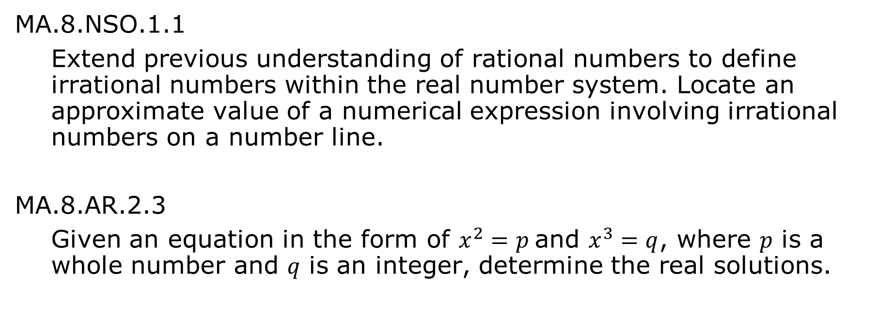
Benchmarks
MA.8.NSO.1.1
Extend previous understanding of rational numbers to define irrational numbers within the real number system. Locate an approximate value of a numerical expression involving irrational numbers on a number line.
MA.8.AR.2.3
Given an equation in the form of $x^{2}=p$ and $x^{3}=q$, where 𝑝 is a whole number and 𝑞 is an integer, determine the real solutions.
volume 1, pg. 55

Slide 3
Integrated Mathematical Thinking and Reasoning Standards
MA.K12.MTR.3.1 Complete tasks with mathematical fluency.
MA.K12.MTR.4.1 Engage in discussions that reflect on the mathematical thinking of self and others.
MA.K12.MTR.5.1 Use patterns and structure to help understand and connect mathematical concepts.
MA.K12.MTR.6.1 Assess the reasonableness of solutions.
volume 1, pg. 55

Slide 4

Learning Targets
I can extend my understanding of square roots and cube roots.
I can compare square roots and cube roots.
I can approximate square roots and cube roots.
volume 1, pg. 55

Slide 5

Warm-Up
volume 1, pg. 56

Slide 6
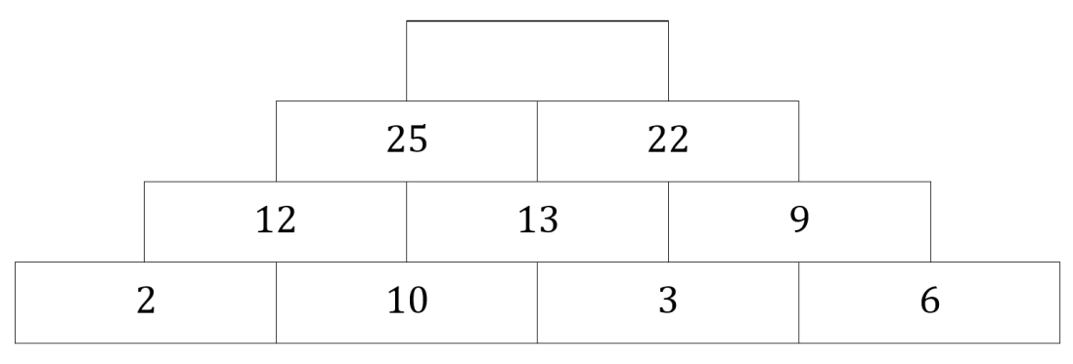
2.4.1 Warm-Up: Number Pattern
A pattern is shown with one value missing.
Determine the value of the empty cell in the pattern.
Explain how you determined the missing value.
volume 1, pg. 56

Slide 7

Collaboration
volume 1, pg. 56

Slide 8

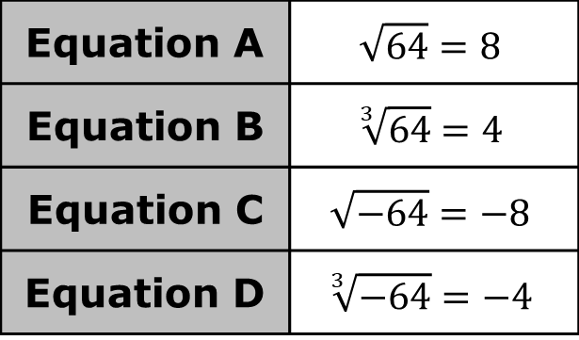
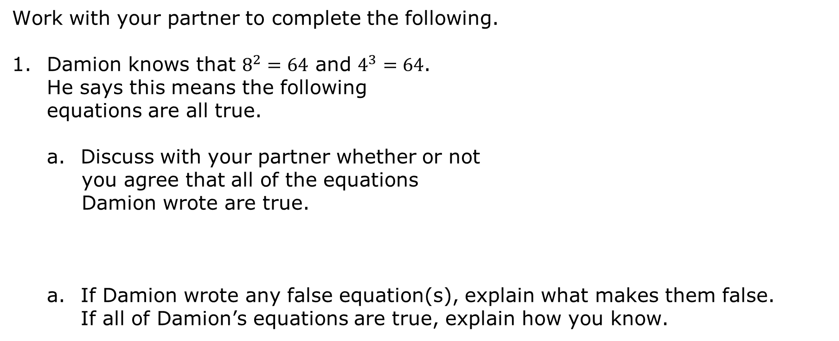
2.4.2 Collaboration: Square Roots vs. Cube Roots
Work with your partner to complete the following.
Damion knows that $8^{2}=64$ and $4^{3}=64$. He says this means the following equations are all true.
Discuss with your partner whether or not
you agree that all of the equations Damion wrote are true.
If Damion wrote any false equation(s), explain what makes them false. If all of Damion’s equations are true, explain how you know.
Equation A | $$\sqrt{64}=8$$
Equation B | $$\sqrt[3]{64}=4$$
Equation C | $$\sqrt{−64}=−8$$
Equation D | $$\sqrt[3]{−64}=−4$$
volume 1, pg. 56

Slide 9
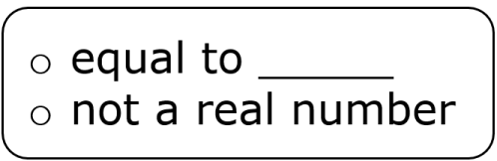
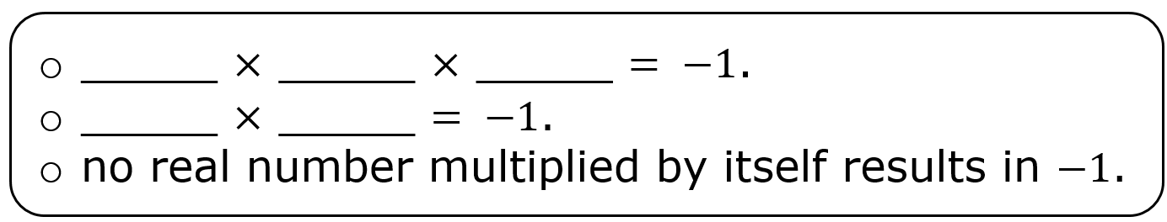

Complete each statement.
$\sqrt[3]{−1}$ is because
$\sqrt{−1}$ is because
volume 1, pg. 57

Slide 10
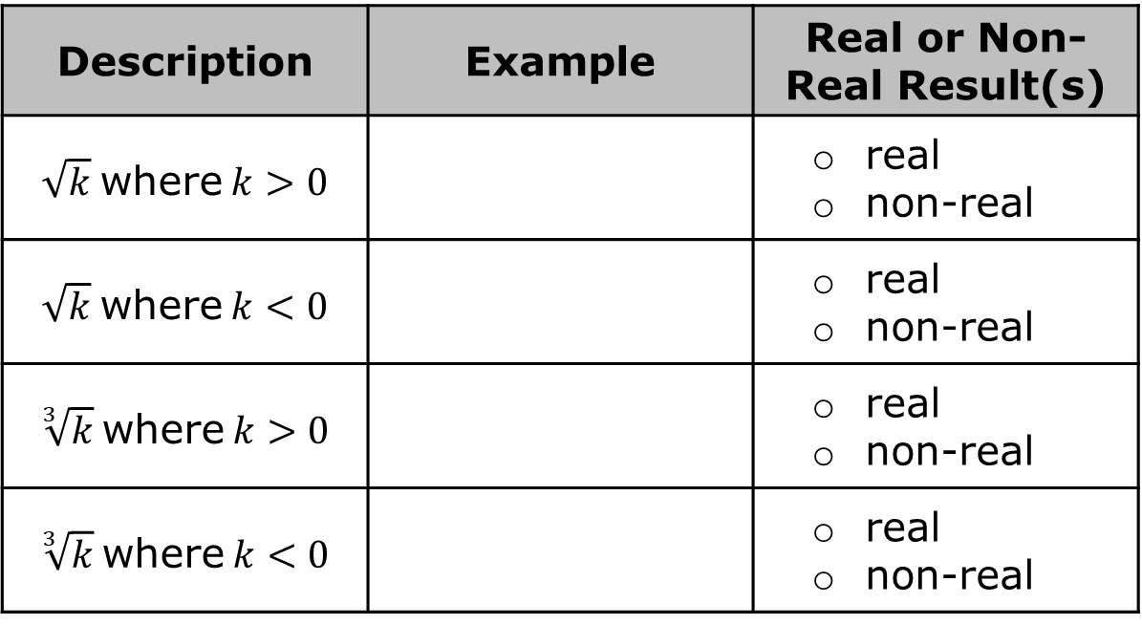

Work with your partner to complete the table by choosing a value of $k$ based on the inequality. Then, determine if the result is real or non-real.
Write a short explanation of when a non-real result will occur.
Description | Example | Real or Non-Real Result(s)
$\sqrt{k}$ where $k>0$ |  | real non-real
$\sqrt{k}$ where $k<0$ |  | real non-real
$\sqrt[3]{k}$ where $k>0$ |  | real non-real
$\sqrt[3]{k}$ where $k<0$ |  | real non-real
volume 1, pg. 57

Slide 11

Exploration
volume 1, pg. 58

Slide 12

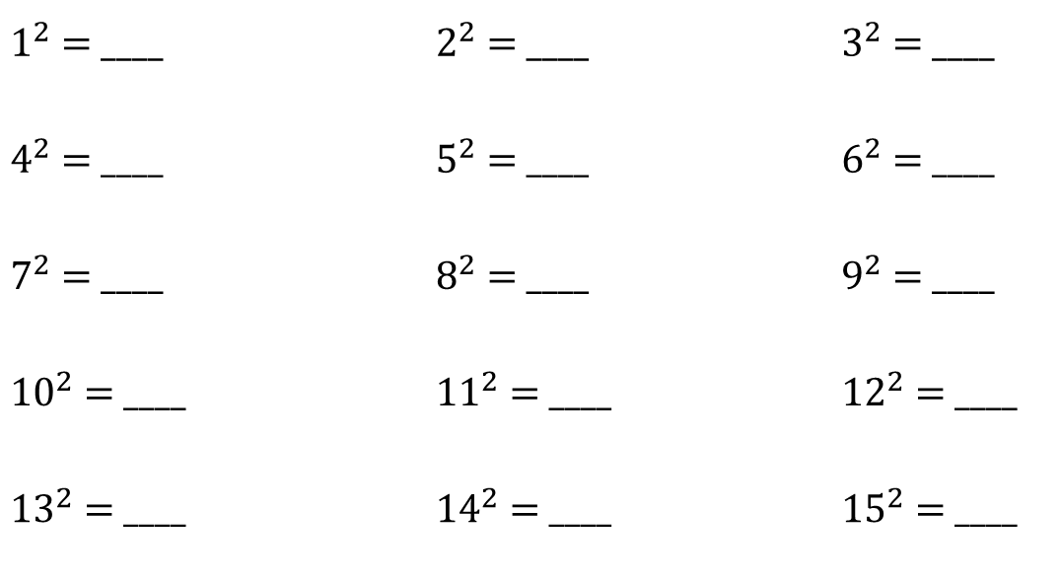
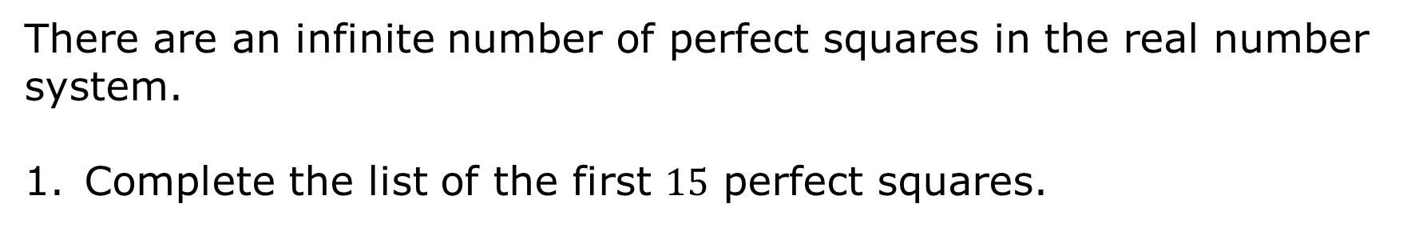
2.4.3 Exploration: Square Roots of Non-Perfect Squares
There are an infinite number of perfect squares in the real number system.
Complete the list of the first $15$ perfect squares.
$1^{2}$ = ____ |  | $2^{2}$ = ____ |  | $3^{2}$ = ____
$4^{2}$ = ____ |  | $5^{2}$ = ____ |  | $6^{2}$ = ____
$7^{2}$ = ____ |  | $8^{2}$ = ____ |  | $9^{2}$ = ____
${10}^{2}$ = ____ |  | ${11}^{2}$ = ____ |  | ${12}^{2}$ = ____
${13}^{2}$ = ____ |  | ${14}^{2}$ = ____ |  | ${15}^{2}$ = ____
volume 1, pg. 58

Slide 13

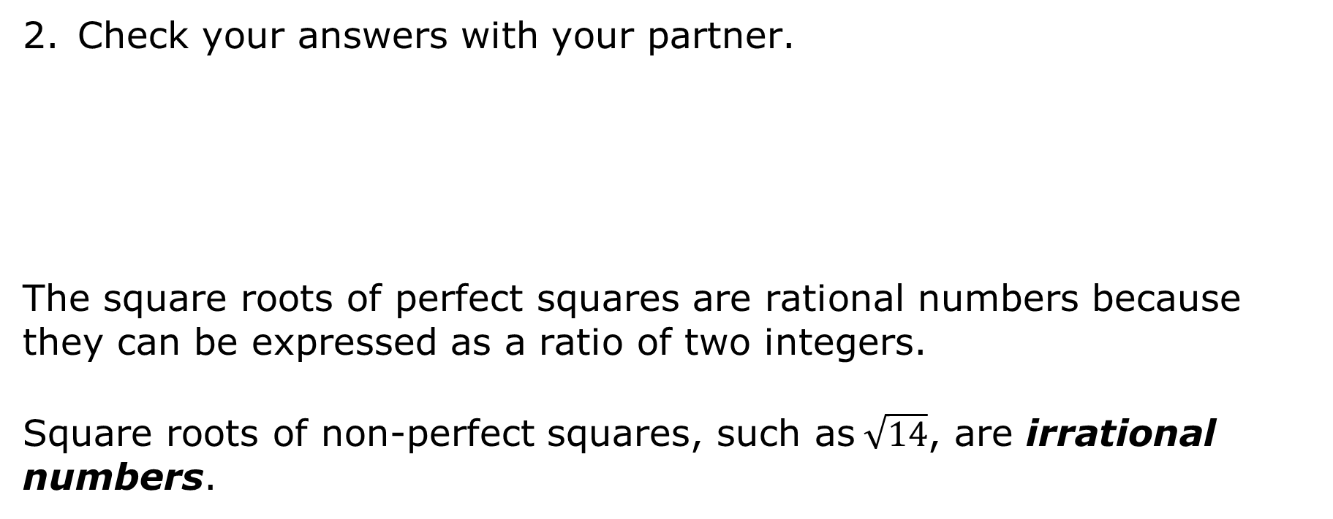
Check your answers with your partner.
The square roots of perfect squares are rational numbers because they can be expressed as a ratio of two integers.
Square roots of non-perfect squares, such as$\sqrt{14}$, are irrational numbers.
Irrational numbers are real numbers that cannot be expressed as a ratio of two integers.
volume 1, pg. 58

Slide 14

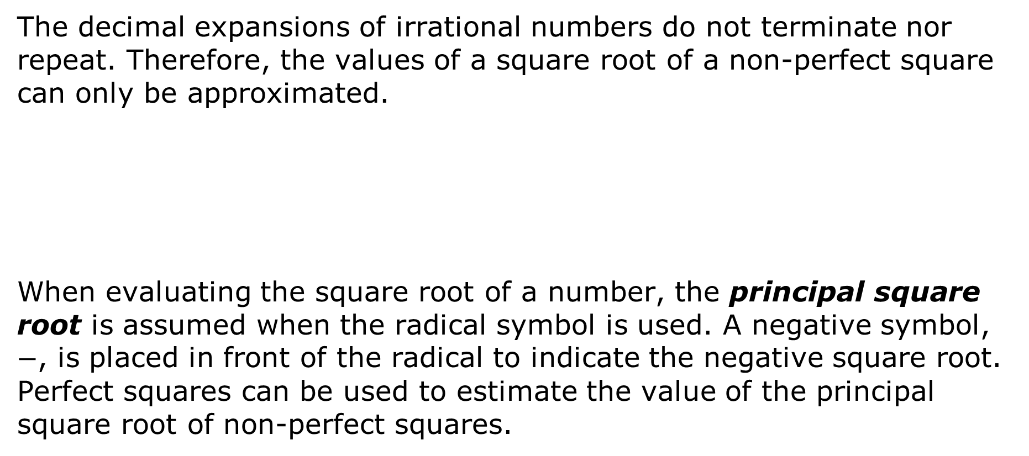
The decimal expansions of irrational numbers do not terminate nor repeat. Therefore, the values of a square root of a non-perfect square can only be approximated.
When evaluating the square root of a number, the principal square root is assumed when the radical symbol is used. A negative symbol, $−$, is placed in front of the radical to indicate the negative square root. Perfect squares can be used to estimate the value of the principal square root of non-perfect squares.
The principal square root is the positive square root of a positive real number.
volume 1, pg. 58

Slide 15
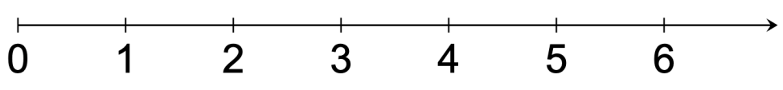


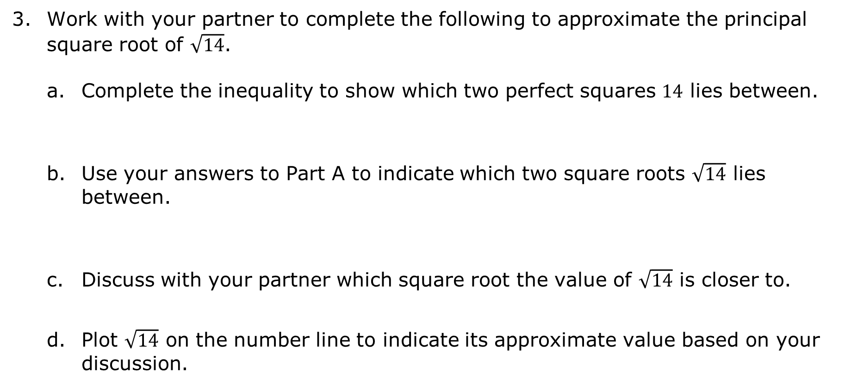
Work with your partner to complete the following to approximate the principal square root of $\sqrt{14}$.
Complete the inequality to show which two perfect squares $14$ lies between.
Use your answers to Part A to indicate which two square roots $\sqrt{14}$ lies between.
Discuss with your partner which square root the value of $\sqrt{14}$ is closer to.
Plot $\sqrt{14}$ on the number line to indicate its approximate value based on your discussion.
________ < $14$ < ________
________ < $\sqrt{14}$ < ________
volume 1, pg. 58

Slide 16



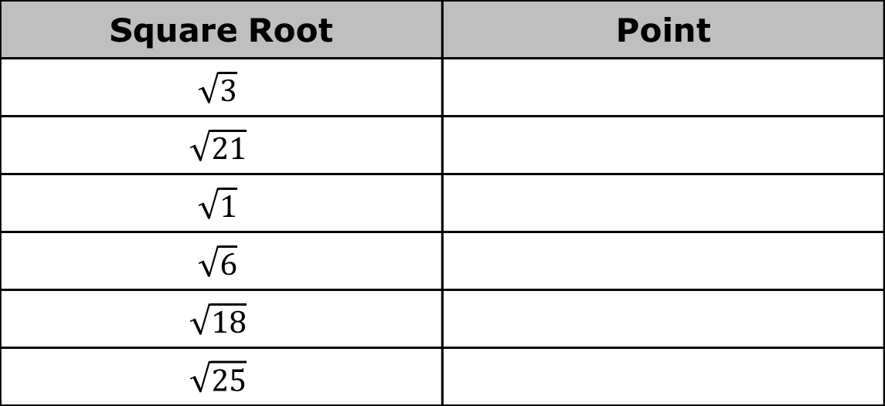



The approximate locations of six square roots are plotted on the number line shown.
Work with your partner to determine which point matches the approximate value of each square root given in the table.
$$F$$
$$C$$
$$M$$
$$L$$
$$Y$$
$$H$$
Square Root | Point
$$\sqrt{3}$$
$$\sqrt{21}$$
$$\sqrt{1}$$
$$\sqrt{6}$$
$$\sqrt{18}$$
$$\sqrt{25}$$
volume 1, pg. 59

Slide 17

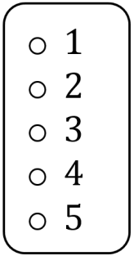
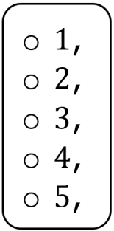
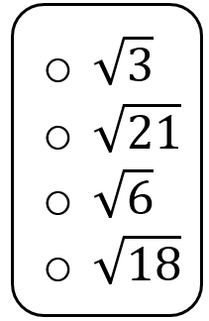
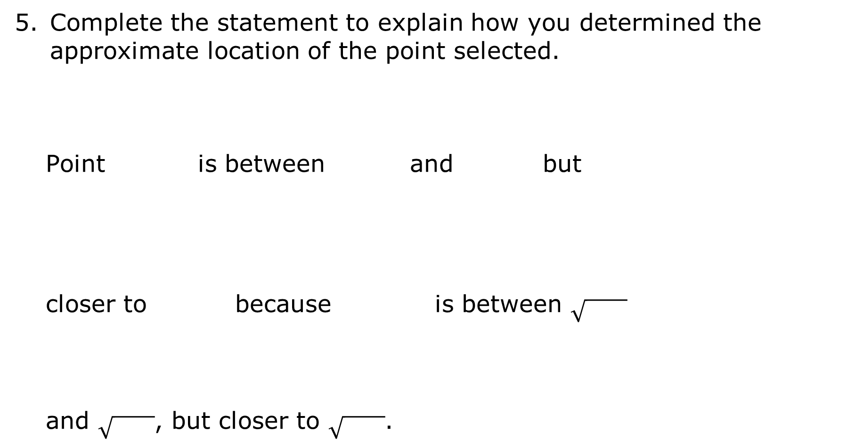
Complete the statement to explain how you determined the approximate location of the point selected.
Point is between and but
closer to because is between
and , but closer to .
volume 1, pg. 59

Slide 18
Exploration
volume 1, pg. 60

Slide 19

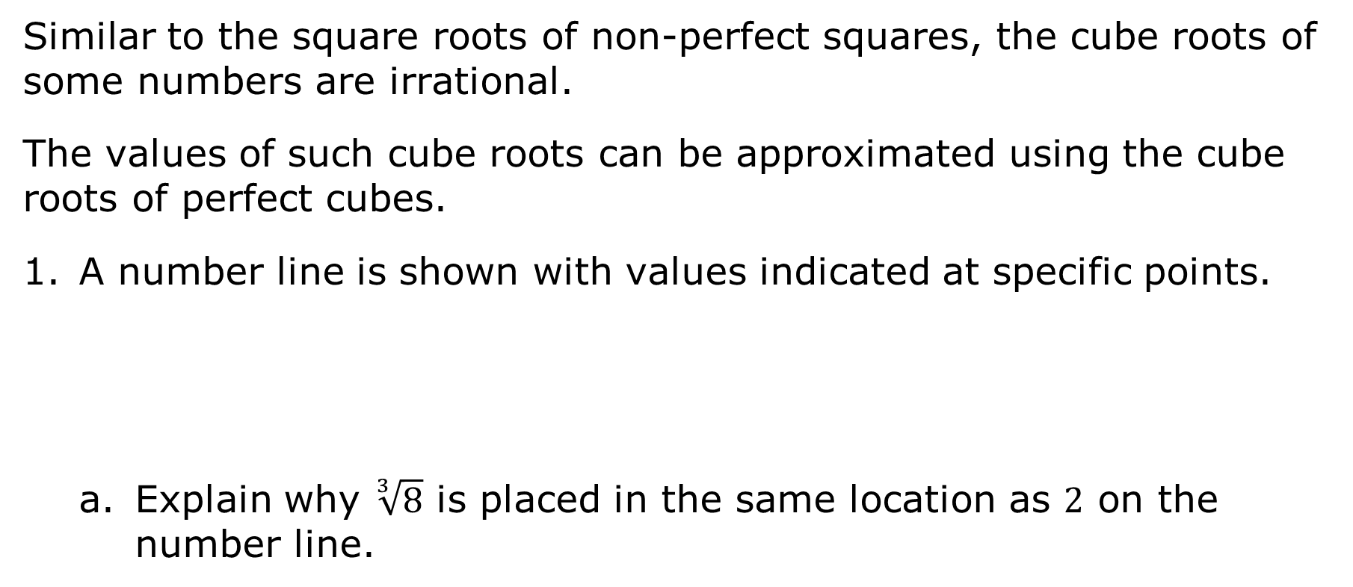


2.4.4 Exploration: Estimating Cube Roots
Similar to the square roots of non-perfect squares, the cube roots of some numbers are irrational.
The values of such cube roots can be approximated using the cube roots of perfect cubes.
A number line is shown with values indicated at specific points.
Explain why $\sqrt[3]{8}$ is placed in the same location as $2$ on the number line.
$$\sqrt[3]{8}$$
$$\sqrt[3]{27}$$
$$\sqrt[3]{64}$$
volume 1, pg. 60

Slide 20
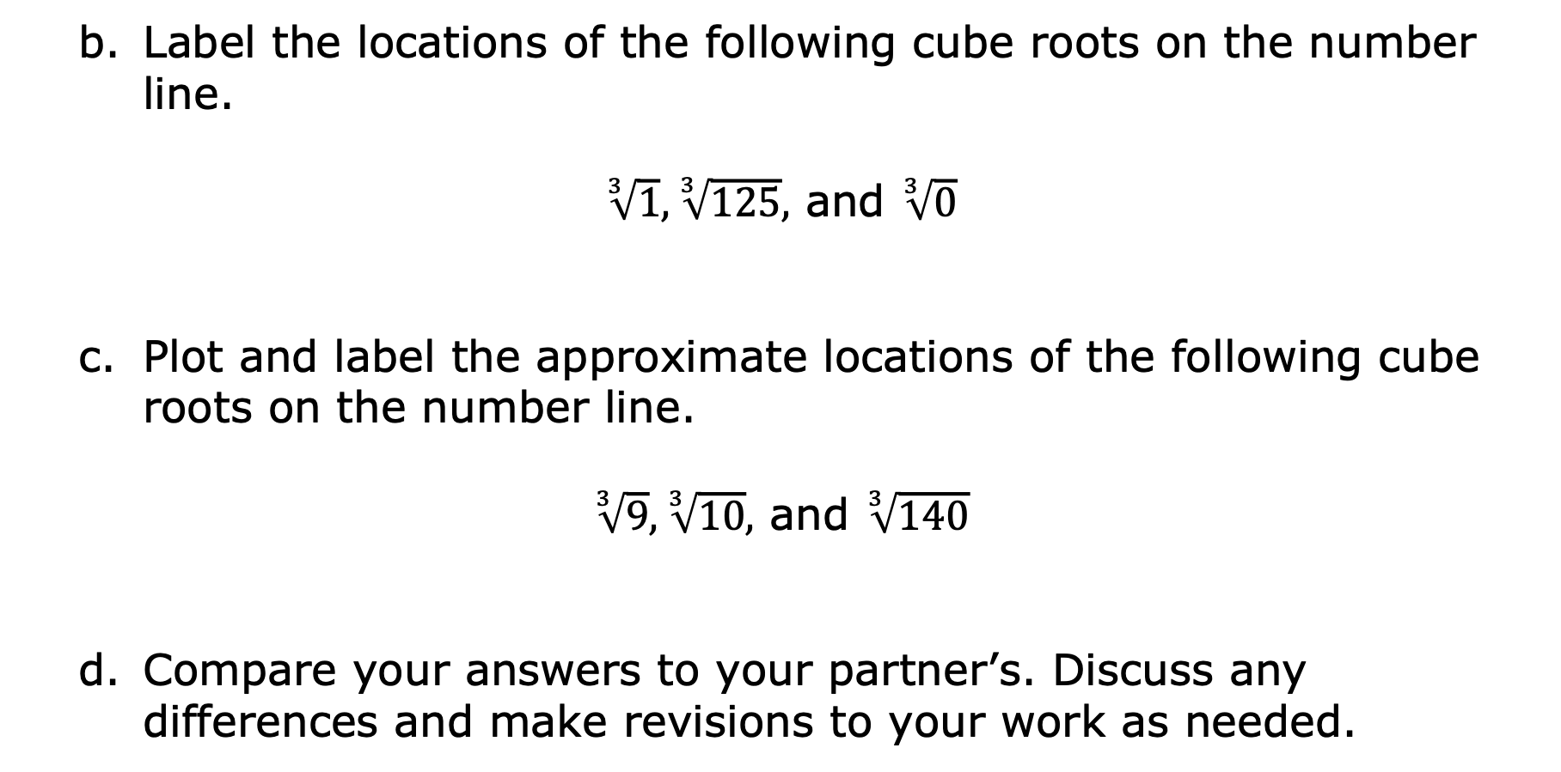
Label the locations of the following cube roots on the number line.
$\sqrt[3]{1}, \sqrt[3]{125},$ and $\sqrt[3]{0}$
Plot and label the approximate locations of the following cube roots on the number line.
$\sqrt[3]{9}, \sqrt[3]{10},$ and $\sqrt[3]{140}$
Compare your answers to your partner’s. Discuss any differences and make revisions to your work as needed.
volume 1, pg. 60

Slide 21

Guided Practice
volume 1, pg. 61

Slide 22

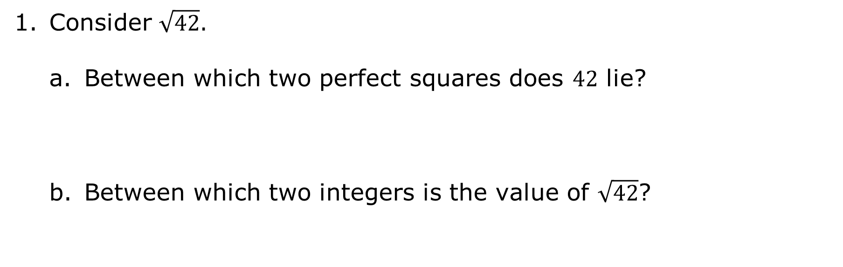
2.4.5 Guided Practice: Locating Square Roots and Cube Roots on a Number Line
Consider $\sqrt{42}$.
Between which two perfect squares does $42$ lie?
Between which two integers is the value of $\sqrt{42}$?
volume 1, pg. 61

Slide 23
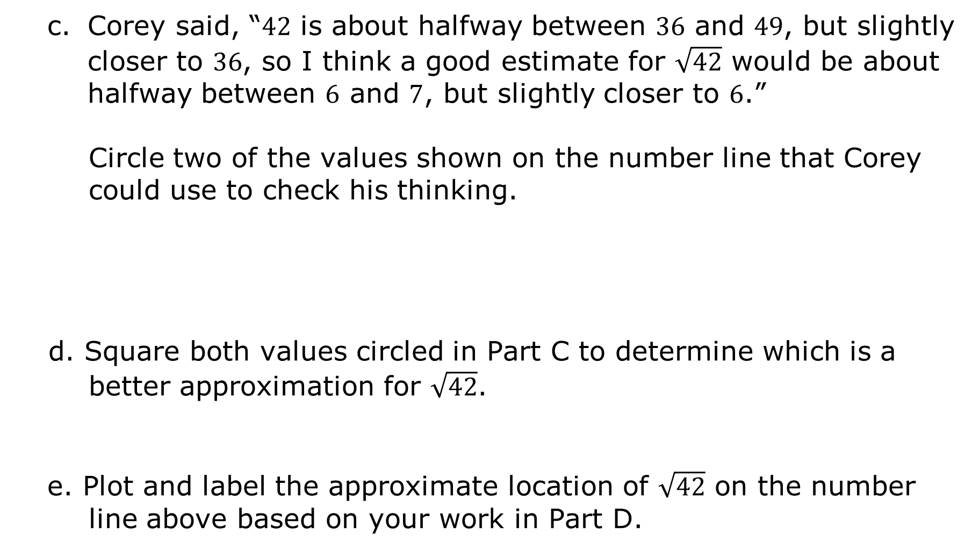
Corey said, “$42$ is about halfway between $36$ and $49$, but slightly closer to $36$, so I think a good estimate for $\sqrt{42}$ would be about halfway between $6$ and $7$, but slightly closer to $6$.”
Circle two of the values shown on the number line that Corey could use to check his thinking.
d. Square both values circled in Part C to determine which is a better approximation for $\sqrt{42}$.
e. Plot and label the approximate location of $\sqrt{42}$ on the number
line above based on your work in Part D.
volume 1, pg. 61

Slide 24
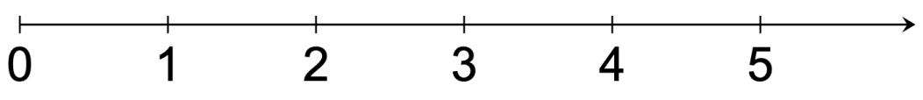
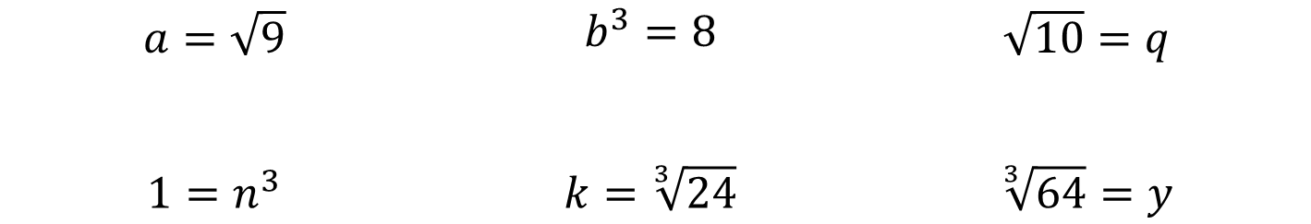
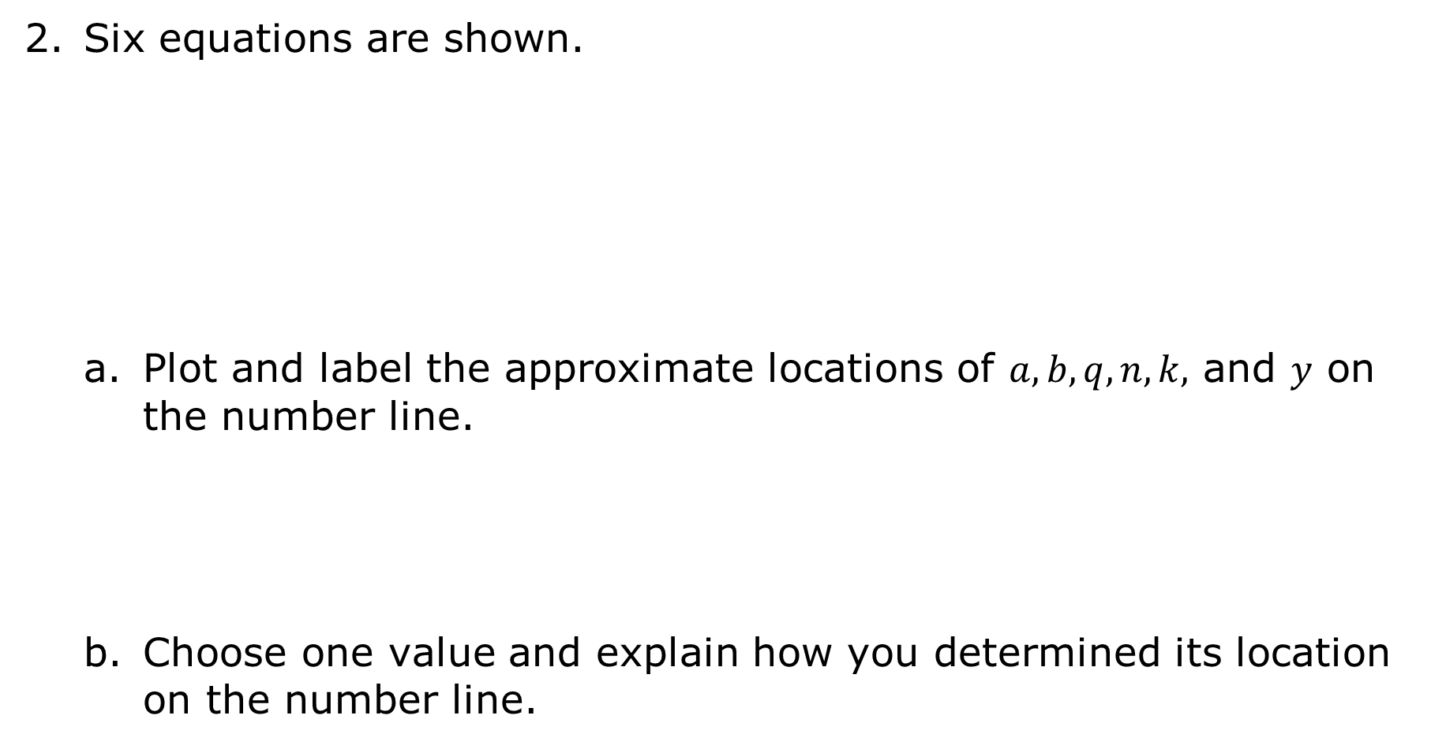
Six equations are shown.
Plot and label the approximate locations of $a, b, q, n, k,$ and $y$ on the number line.
Choose one value and explain how you determined its location on the number line.
$$a=\sqrt{9}$$ | $$b^{3}=8$$ | $$\sqrt{10}=q$$
$$1=n^{3}$$ | $$k=\sqrt[3]{24}$$ | $$\sqrt[3]{64}=y$$
volume 1, pg. 61

Slide 25

Wrap-Up
volume 1, pg. 62

Slide 26
2.4.6 Wrap-Up: Growth Mindset
“Don’t be afraid of failure. This is the way to succeed.”
- Lebron James
Complete each statement.
Today I found a way to succeed at…
Today I did not give up on learning…
volume 1, pg. 62

